Slide 1
BMC Cyber and Cloud Summer Courses Deep Learning for Computer Vision Introduction to Python
Samuel Adebayo
sadebayo@belfastmet.ac.uk

Slide 2
Contents
What is Python?
Jupyter Notebook
Variables
Types
Errors
Operators
Logic
Printing
Data Structures
Slices
Loops
Functions
Classes
Libraries

Slide 3
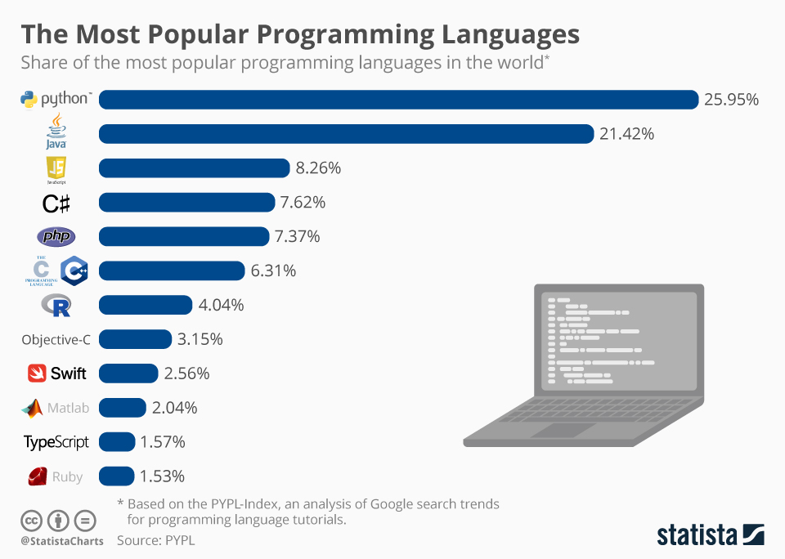
What is Python
There are lots of programming languages, Python is just one of them.
You can easily get computers to do very complex tasks in a short amount of time.
It’s the most popular language and not that hard to learn, so it’s worth spending a little bit of time with it.
If you want a career in tech, or just want to talk to the bitcoin bros about it, this is a great place to start.

Slide 4
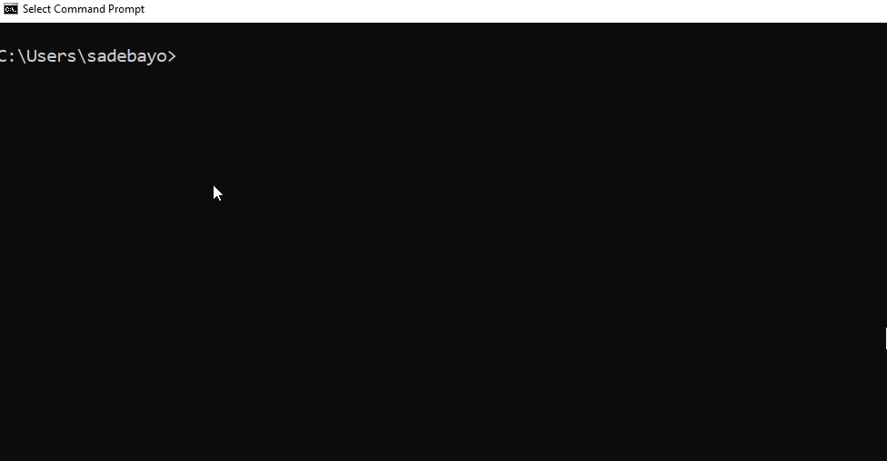
Jupyter Notebooks
Python is normally run from the ‘terminal’, which is the black program you often see hackers using in films.
You can also run them from Jupyter Notebooks, which allows you to run the code without using the terminal.
Notebooks are a lot easier to use and allow you to break the program up.
If you follow the link in the chat, you’ll be able to make your own copy of the notebook for this course.

Slide 5
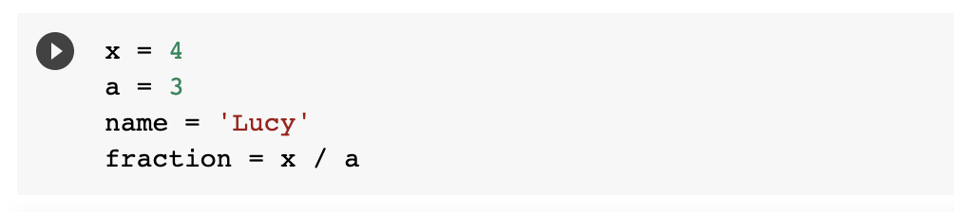
Variables
In programming we need to give objects (number/words/images etc.) names.
This is done using the following syntax.
We can then access the object using the variable name.
What is the value of fraction?

Slide 6
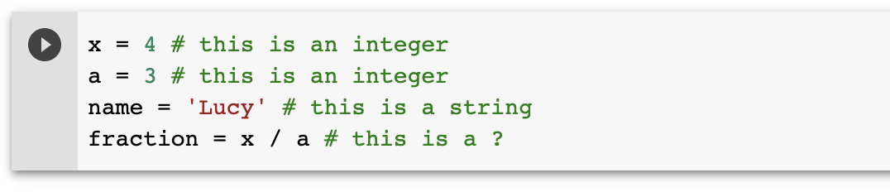
Types
Python stores variables depending on the ‘type’
It’s important to remember that types are not equivalent!

Slide 7
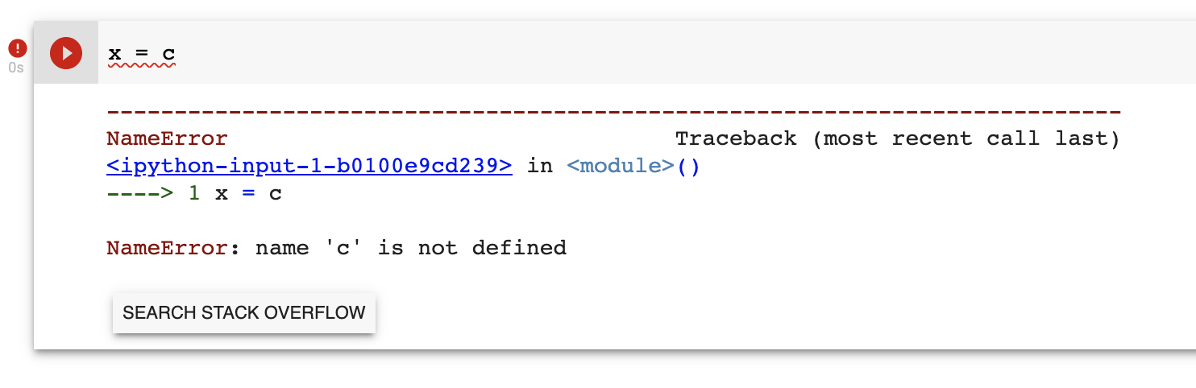
Error Messages
Python will throw an error if there’s an issue.
Try and work out the error, but don’t be afraid to Google it!

Slide 8
Operators
We often want to perform operations on variables that are numerical.
Function | Operator
Multiply | *
Add | +
Divide | /
Subtract | -
Power | **
Modulo | %

Slide 9
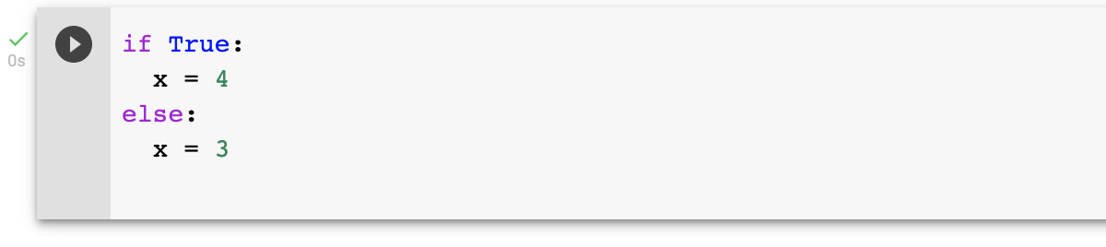
Logic
In programming we sometimes need to check if things are true or false.
This is achieved through if/else statements. What is the value of x?

Slide 10
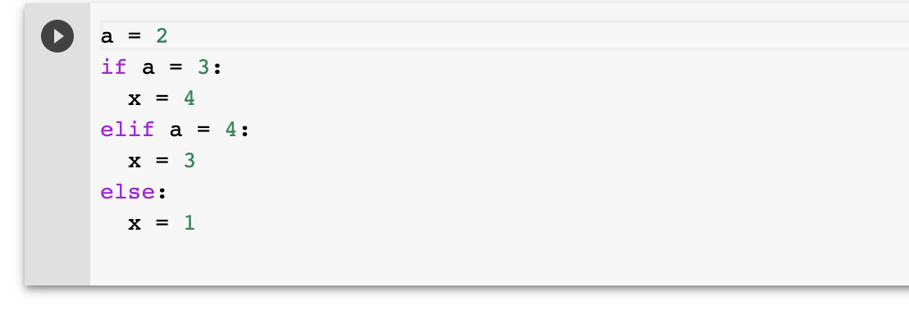
More Logic
We can check the value of variables like so.
What is the value of x?

Slide 11
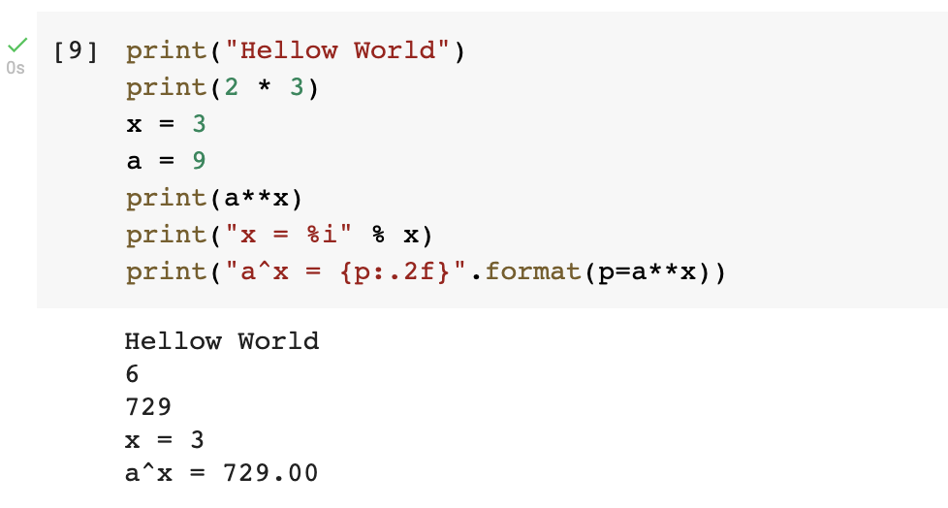
Printing
We can print out the value of variables, this helps when debugging.
There are many ways in which you can print values...

Slide 12
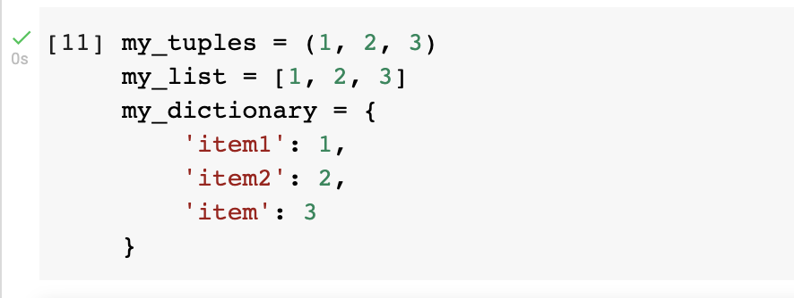
Data Structures
In programming we often need ways to store lots of data, we do this in data structures.
The main ones are: lists [], tuples () and dictionaries {}.

Slide 13
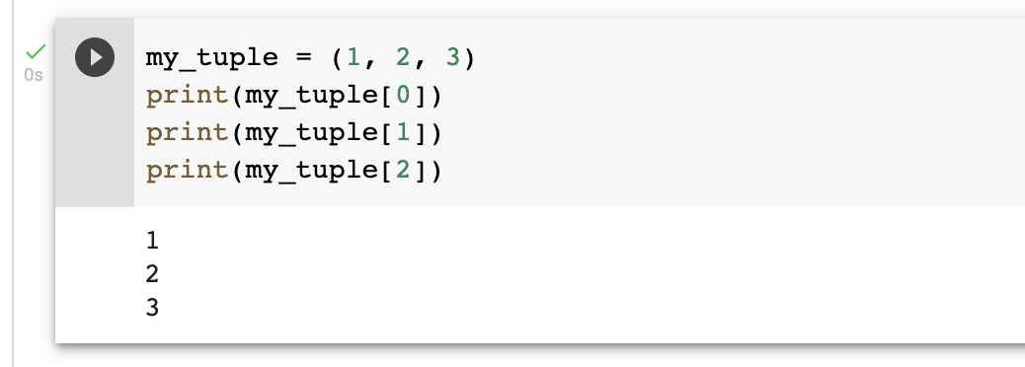
Tuples
Tuples store arrays of data.
We can access elements of the tuples by indexing the tuple.
Tuple values can’t be changed!
We count from 0 in programming, what would the value of my_tuples[3] be?

Slide 14
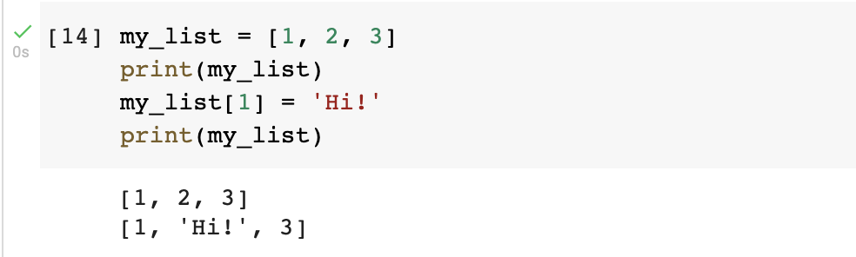
Lists
Lists are like tuples but we can change their values.

Slide 15
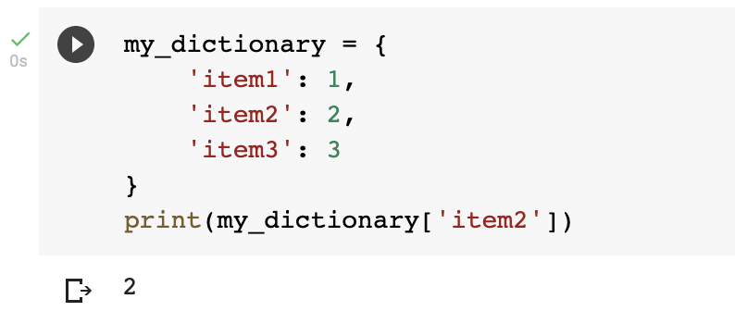
Dictionaries
Dictionaries are stored using a ‘hash table’ and the values are accessed using the key.

Slide 16
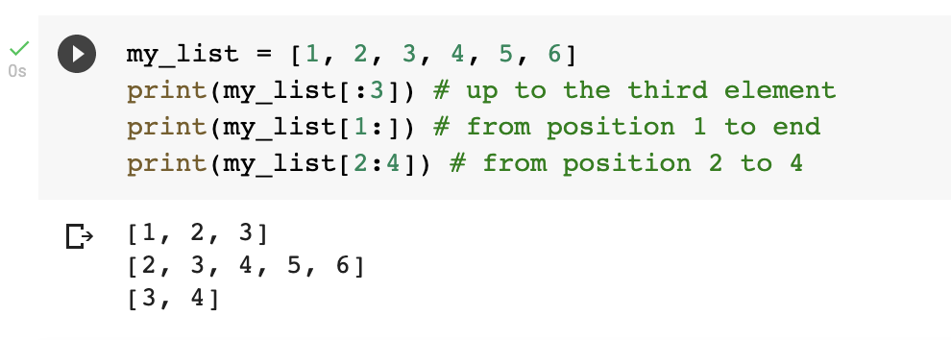
Slices
We can access ranges of lists.

Slide 17
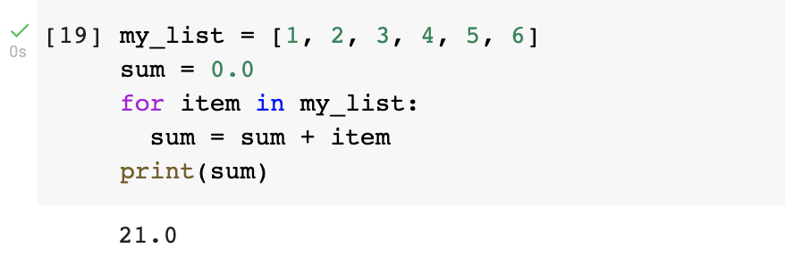
Loops
Sometimes we need to do the same operation multiple times.
E.g. when adding numbers in a list.

Slide 18
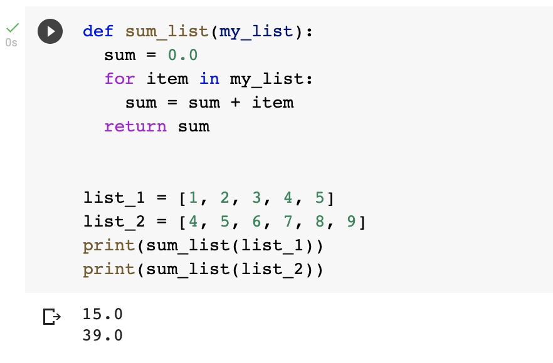
Functions
Functions make life a lot easier when writing lots of code.
It allows us to separate out pieces of the codebase.
If you’re going to do the same set of operations more than twice, it should be a function.

Slide 19
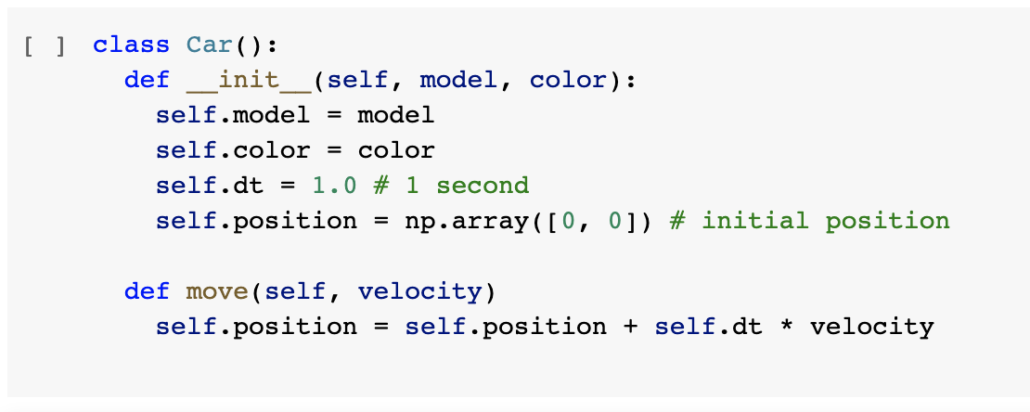
Classes
Classes can be seen as a way to group functions together which act on an ‘abstract’ object.
Think of them as a programming way to describe objects.
This is a complicated concept, and takes and time to understand, so don’t worry too much if you don’t get it straight away.

Slide 20
Classes
Every object needs a constructor. This function is what ‘builds’ the class

Slide 21
Classes
These are member variables of the class
We can update member variables using ‘self’

Slide 22
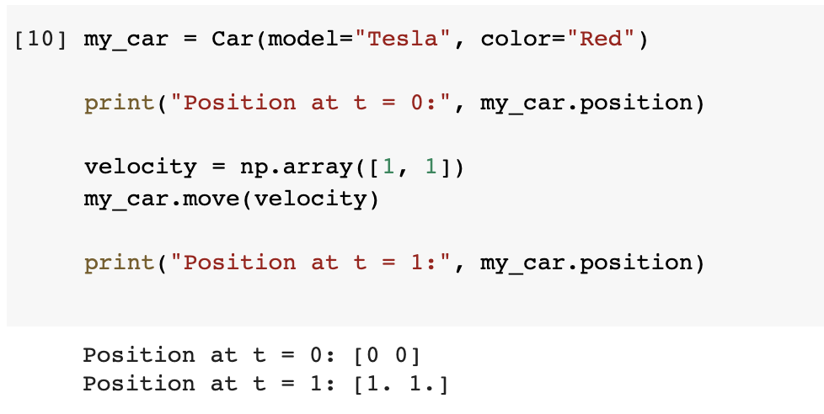
Using classes
Instantiate the class

Slide 23
Using classes
Print out the position

Slide 24
Using classes
Move the car

Slide 25
Using classes
Print out the position

Slide 26
Modules in Python
What was ‘np’?
np is short for numpy, which is python module containing lots of functionality for arrays and matrices.
This means we don’t have to use lists, and can do things like multiplication and summations very easily.
You’ll experiment with numpy in the hands-on session.

Slide 27
That’s it!
Hang on to these slides, they’ll help you in the breakout session.
I hope this has given you a taste of Python and some idea of what to expect when using it.
Questions?

Slide 28

Thank You
See you soon

